Slide 1
TOP – DOWN Splay Trees
Bottom-up splaying requires traversal from root to the node that is to be splayed, and then rotating back to the root – in other words, we make 2 tree traversals. We would like to eliminate one of these traversals.
It’s very easy to do this: each time we follow a left link (from let us say, node X), then X and its right subtree are all > the node which will eventually become the root. So, we save X and its right subtree in a separate tree, which we will call R. The symmetric case (following a right link) identifies subtrees which will become part of the new root’s left subtree, which we will call L.
The 3 reorganization cases for Bottom Up Splay Trees were Zig, Zig-Zig, and Zig-Zag. Top-Down Splay Trees use only 2 cases: Zig and Zig-Zig. Zig-Zag is reduced to a Zig, and either a second Zig, or a Zig-Zig.
Note that we are able to make the correct choice about the final locations of vertices as we descend the tree, thus saving about ½ of the time a BU splay tree would require

Slide 2
Space for T.D. splay tree is O(1) for pointers to L and R, and also, to make things more efficient, we maintain pointers to the insertion points for new nodes in L and R.
Those insertion points are the right child of the maximum element in L, and the left child of the minimum element in R.
By maintaining these pointers, we avoid the need to traverse L or R. (an immediate consequence of this: after a vertex and subtree are added to L or R, they do not change their positions in L or R).

Slide 3
Case 1: Zig
L
X
R
L
R
Y
X
Y
XR
YL
Yr
XR
YL
Yr
If Y should become root, then X and its right subtree are made left children of the smallest value in R, and Y is made root of “center” tree

Slide 4
Case 2: Zig-Zig
L
X
R
L
R
Z
Y
XR
Y
Z
ZL
Zr
X
YR
YR
XR
ZL
Zr
The value to be splayed is in the tree rooted at Z. Rotate Y about X and attach as left child of smallest value in R

Slide 5
Case 3: Zig-Zag(Simplified)
L
X
R
L
R
Y
Y
XR
X
YL
YL
Z
Z
XR
ZL
Zr
ZL
Zr
The value to be splayed is in the tree rooted at Z. To make code simpler, the Zig-Zag rotation is reduced to a single Zig. This results in more iterations in the splay process.

Slide 6
Reassembling the Splay Tree
L
X
R
X
L
R
XL
XR
XL
XR
When the value to be splayed to the root is at the root of the “center” tree, we have reached the point where we are ready to reassemble the tree. This is accomplished by a) making XL the right child of the maximum element in L, b) making XR the left child of the minimum element in R, and then making L and R the left and right children of X

Slide 7
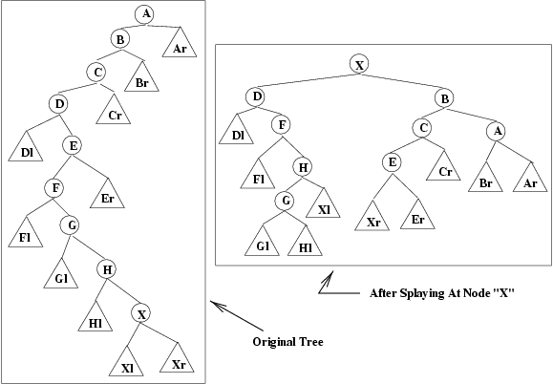
Example: (from bottom-up)

Slide 8
Operation 1: Zig-Zig
L
R
L
R
A
C
Ar
B
B
D
Cr
Br
A
C
Dl
E
Cr
Er
Br
Ar
D
F
Dl
E
G
Fl
Er
H
F
Gl
G
Hl
X
Fl
H
Xl
Xr
Gl
Hl
X
Xl
Xr
L is still empty, and R is now the tree rooted at B. Note that R contains nodes > X but not in the right subtree of X.
Rotate B around A and make L child of minimum element in R (which is now empty)

Slide 9
Operation 2: Zig-Zag
L
R
L
R
C
E
Cr
B
D
B
D
Er
A
F
Dl
E
Dl
C
A
Fl
G
Er
Br
Ar
Cr
Br
Ar
F
H
Gl
Fl
G
Hl
X
H
Xl
Xr
Gl
Hl
X
Xl
Xr
L was previously empty and it now consists of node D and D’s left subtree
Just perform Zig (simplified Zig-Zag)

Slide 10
After X reaches root:
L
R
X
This configuration was achieved by doing Zig Zig (of F, G) followed by a Zig (node H)
D
Xl
Xr
B
Dl
G
A
C
F
H
Cr
Br
Ar
Hl
E
Fl
Gl
Er
Reassemble – XL becomes right subtree of H, XR becomes left subtree of E, and then L, R reattached to X
X
B
D
C
A
Note that this is not the same tree as was obtained by doing BU splaying.
Dl
G
H
Cr
Br
Ar
F
E
Hl
Xl
Er
Fl
Gl

